Slide 1
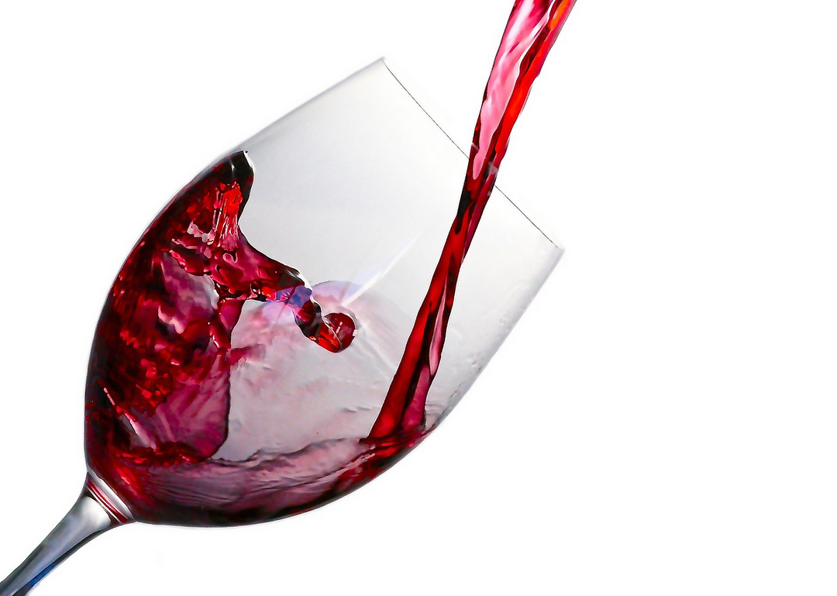
Wine Quality Prediction
EXPLORING MACHINE LEARNING TECHNIQUES TO PREDICT THE QUALITY OF WINE BASED ON VARIOUS PARAMETERS.
PRESENTED BY
Group - 11

Slide 2
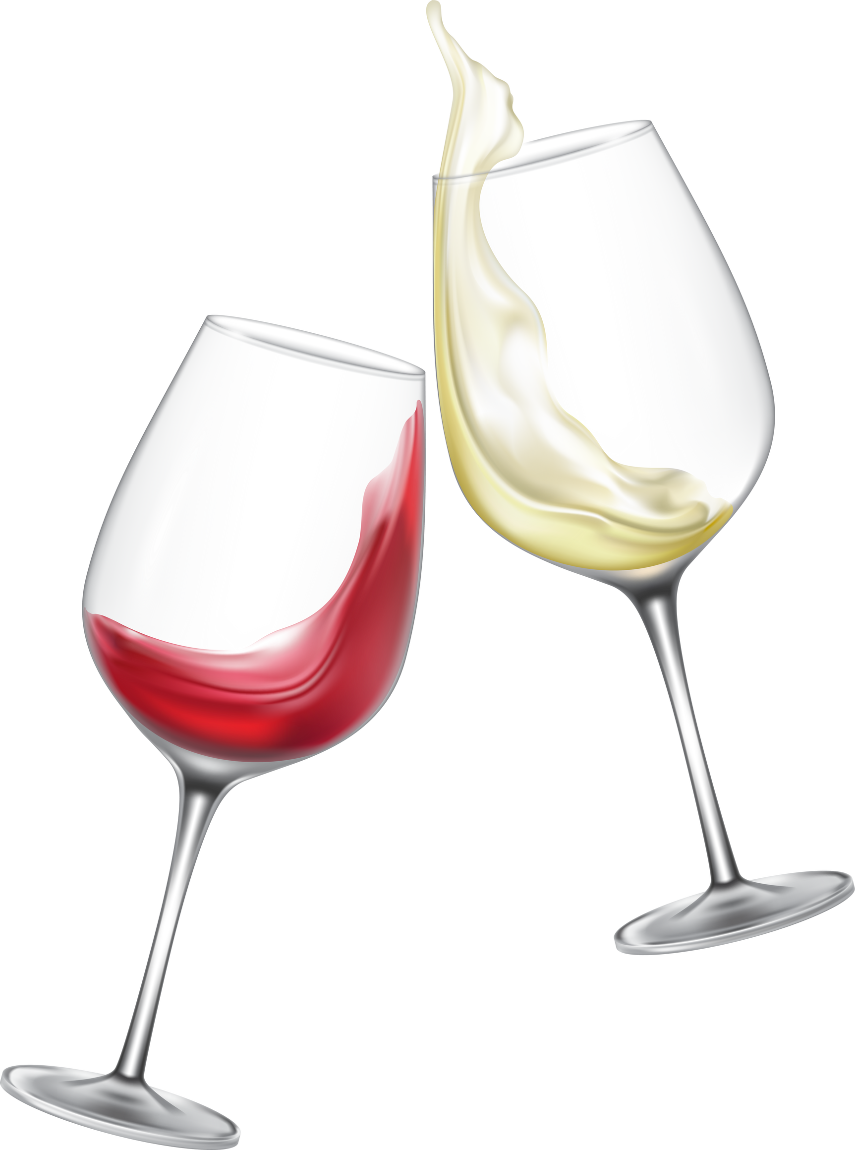
Introduction
This project aims to develop a predictive model using machine learning techniques to assess the quality of wine based on its chemical properties. By analyzing the dataset and leveraging various algorithms, we seek to provide winemakers with insights to optimize production processes and enhance overall quality. Our key objectives include analyzing the dataset, developing and evaluating machine learning models, and exploring model ensembling techniques to improve predictive performance.
PREDICTING WINE QUALITY

Slide 3





TECHNOLOGIES AND LIBRARIES USED

Slide 4
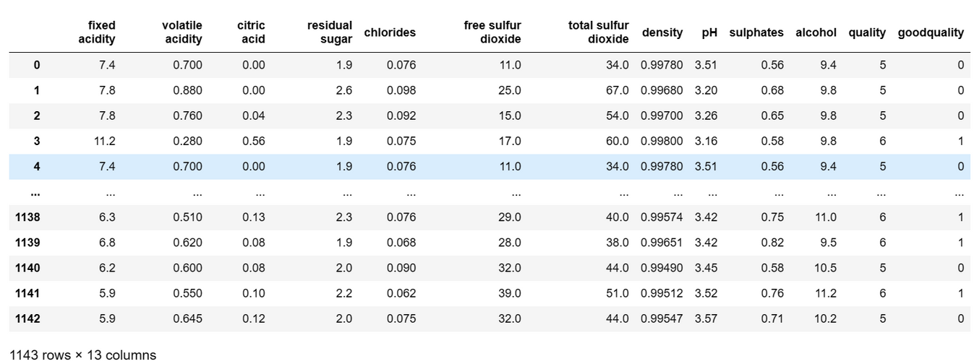
Data Extraction
Source of Data: The dataset utilized in this project was obtained from Kaggle.
Overview: The dataset comprises data on different chemical attributes of wine such as fixed acidity, volatile acidity, citric acid, residual sugar, chlorides, free sulfur dioxide, total sulfur dioxide, density, pH, sulphates, alcohol, and quality.
Structure: Available in CSV format, the dataset comprises 1143 samples.

Slide 5

Data Exploration
Missing Values Handling:
Identified and addressed missing values in the dataset using techniques such as imputation or deletion based on the nature of the missing data.
A thorough examination of the dataset found no missing values, ensuring a complete and reliable dataset for the analysis
Missing Values Handling: Identified and addressed missing values in the dataset using techniques such as imputation or deletion based on the nature of the missing data.

Slide 6

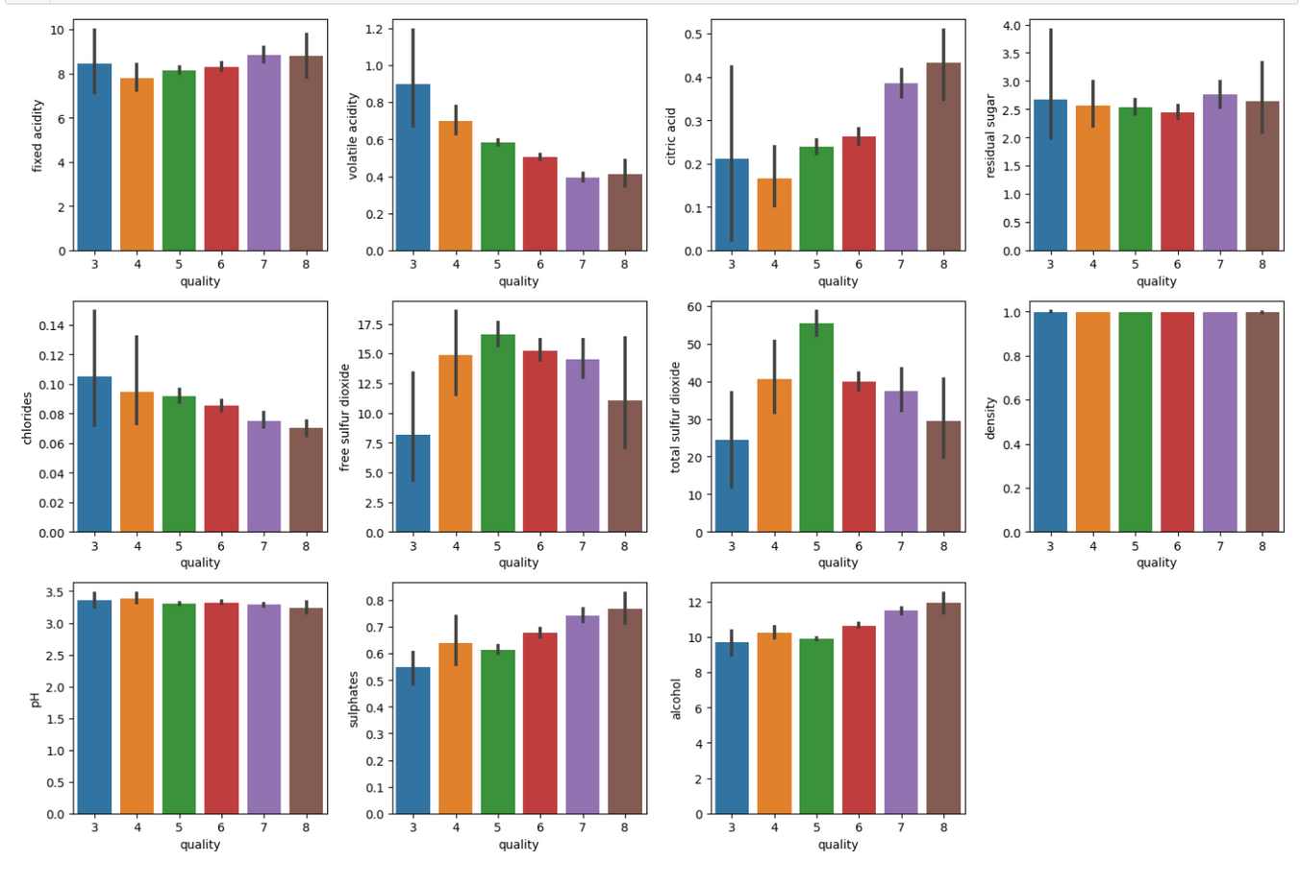
Visualizing the relationship between wine quality ratings and various chemical properties.
It illustrate the average values of various chemical properties across different quality ratings of wine, providing insights into the factors that contribute to wine quality.

Slide 7
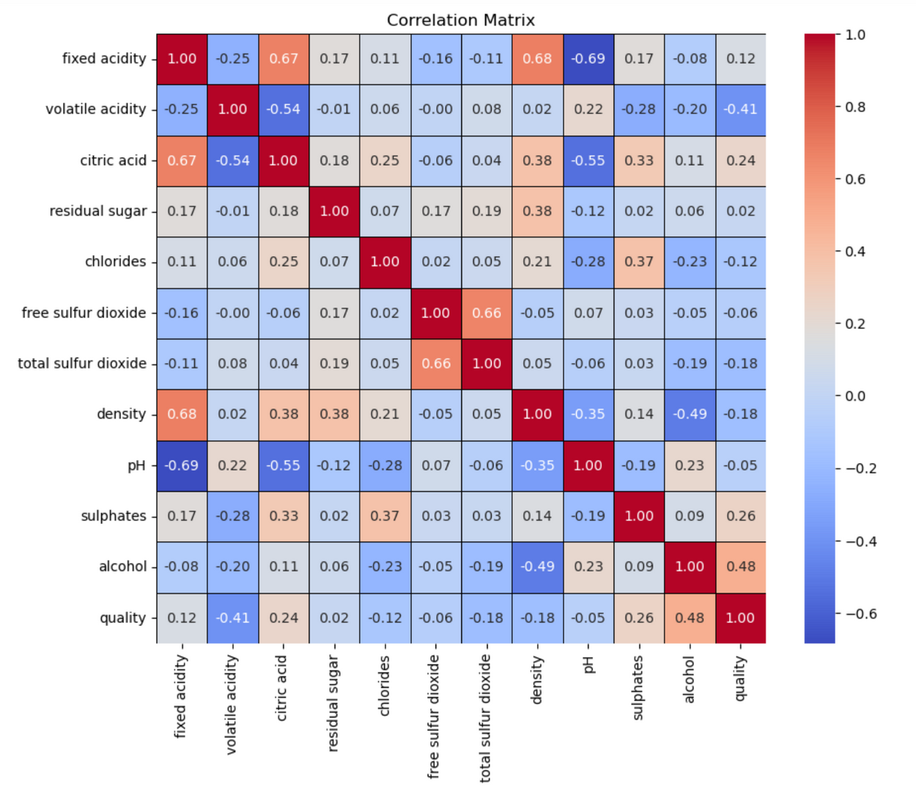
Visualizing the correlation between different chemical properties of wine using a heatmap.
It is utilized to display the correlation matrix of the wine dataset, highlighting the relationships between different chemical properties and their impact on wine quality.

Slide 8
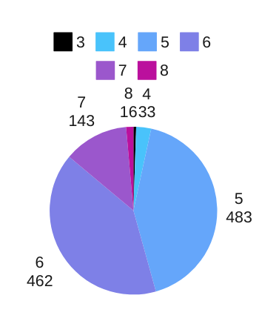
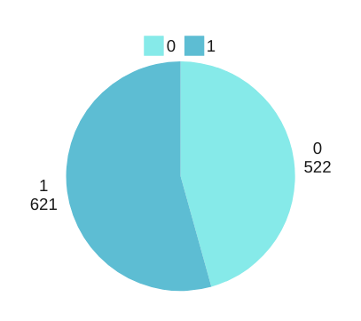
FEATURE SELECTION
Target Variable Identification:
The target variable for this project is the quality rating of wine, which serves as the label for prediction.
QULAITY
RANGE FROM 3 TO 8
Target Variable Transformation:
To facilitate binary classification, the target variable "quality" is transformed into a binary variable named "good quality."
Wines with a quality rating of 6 or higher are labeled as "1" (indicating good quality), while wines with a rating below 6 are labeled as "0" (indicating lower quality).
GOOD AND BAD QUALITY

Slide 9
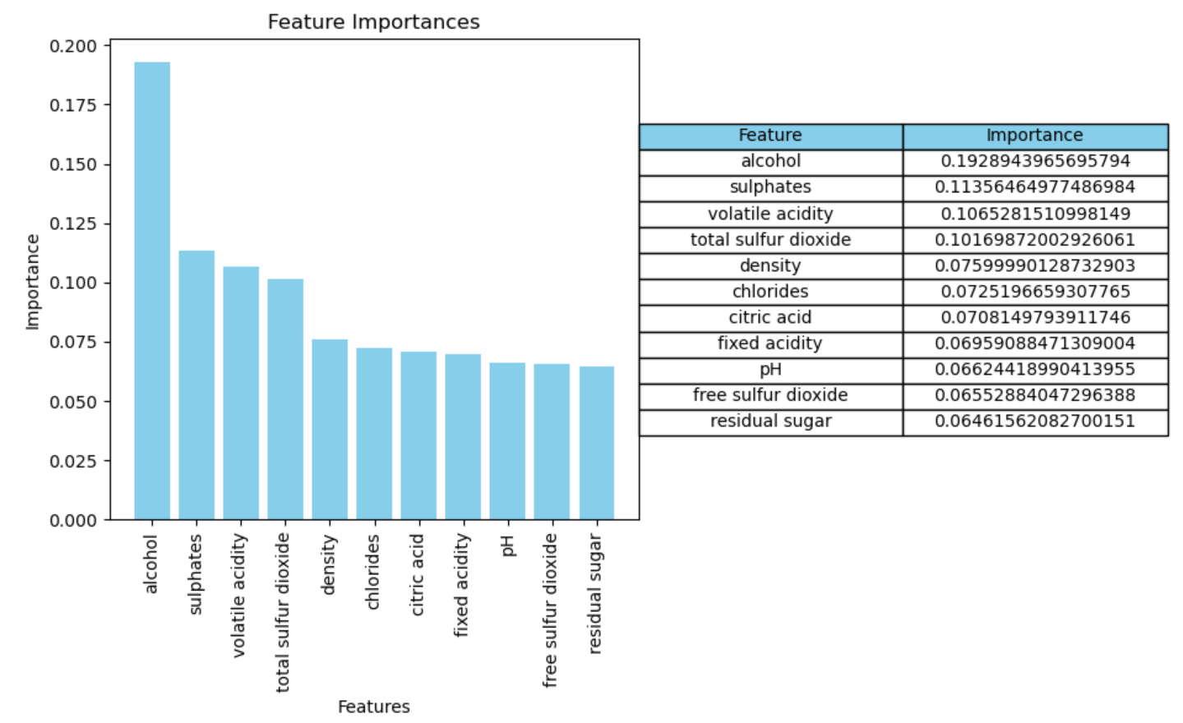
FEATURE IMPORTANCE
Feature importance analysis is conducted to identify the most influential chemical properties that contribute to wine quality.
Techniques such as ExtraTreesClassifier are employed to rank the features based on their importance scores, aiding in model optimization and interpretation.
Top 5 most important features:
alcohol
sulphates
volatile acidity
total sulfur dioxide
density

Slide 10



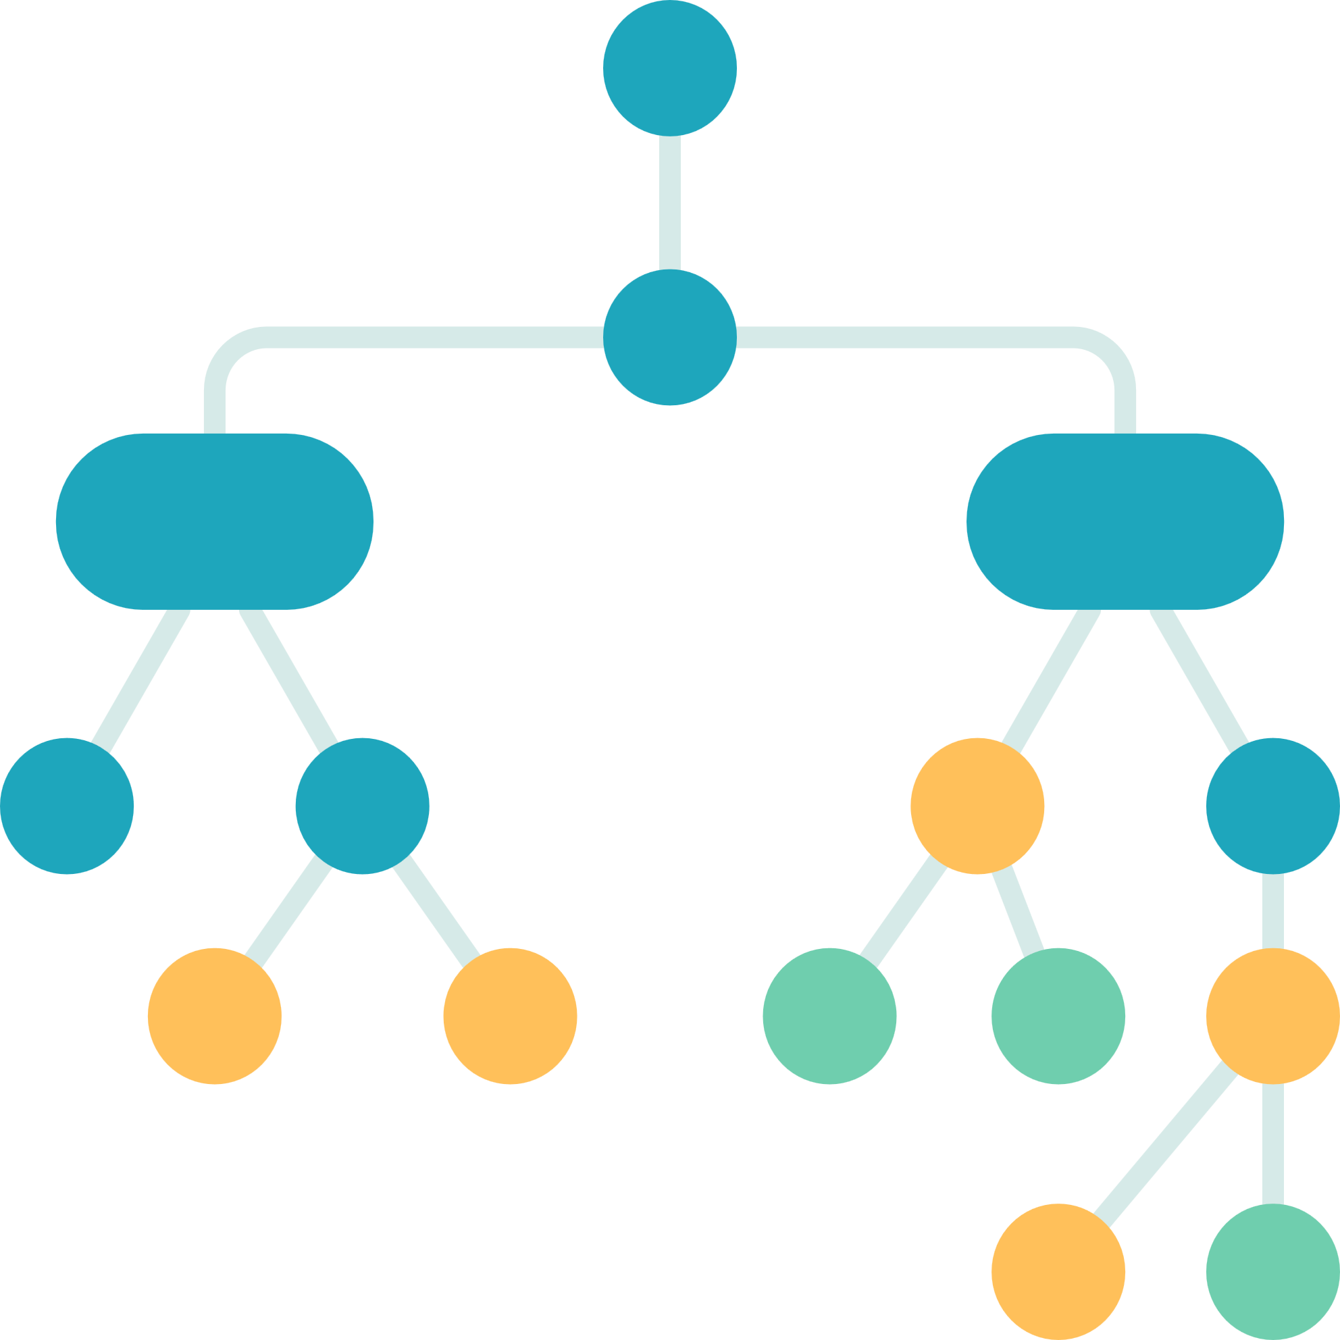
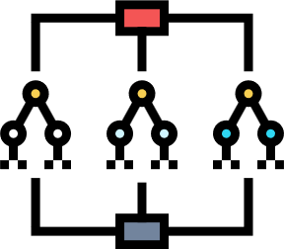
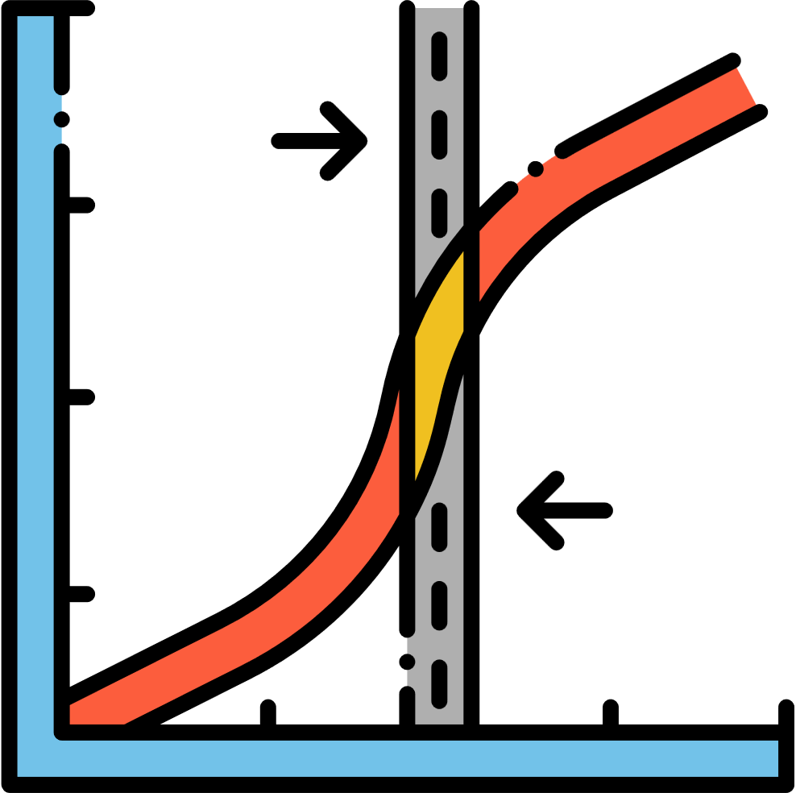



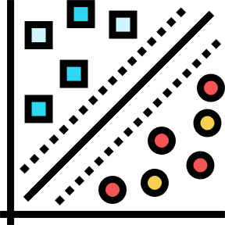


MULTI MODEL EVALUATION
Random Forest
Logistic Regression
Decison tree
Support Vector Machine
Gaussian NB
KNN

Slide 11
MODEL EVALUATION
LOGISTIC REGRESSION:
DECISION TREE:
Achieved an accuracy of 75.98% with balanced precision and recall scores, resulting in an F1 score of 78.43%. It correctly classified 74 true negatives and 100 true positives, with 28 false positives and 27 false negatives.
Attained an accuracy of 66.81% with similar precision and recall scores, yielding an F1 score of 70.08%. It correctly predicted 64 true negatives and 89 true positives, with 38 false positives and 38 false negatives.
RANDOM FOREST:
K NEAREST NEIGHBOUR:
Achieved highest accuracy of 78.60%, with precision and recall scores of 80.95% and 80.31%, respectively, resulting in an F1 score of 80.63%. It accurately classified 78 true negatives and 102 true positives, with 24 false positives and 25 false negatives.
Achieved an accuracy of 65.50%, with precision and recall scores of 70.00% and 66.14%, respectively, resulting in an F1 score of 68.02%. It correctly classified 66 true negatives and 84 true positives, with 36 false positives and 43 false negatives.
SUPPORT VECTOR CLASSIFIER:
GAUSSIAN NAIVE BAYES:
Attained an accuracy of 67.25% with a higher recall score of 92.13% compared to precision, resulting in an F1 score of 75.73%. It correctly predicted 37 true negatives and 117 true positives, with 65 false positives and 10 false negatives.
Achieved an accuracy of 72.93% with balanced precision and recall scores, resulting in an F1 score of 75.00%. It correctly classified 74 true negatives and 93 true positives, with 28 false positives and 34 false negatives.

Slide 12
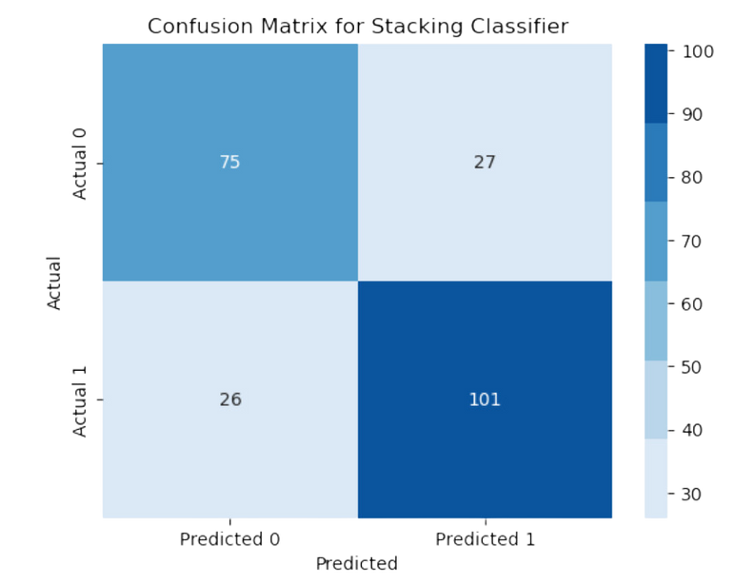
MODEL ENSEMBLING
Overall Model Evaluation:
The Random Forest model achieved the highest accuracy of 78.60%, followed by Logistic Regression with an accuracy of 75.98%, and Gaussian Naive Bayes with an accuracy of 72.93%.
These three models demonstrated competitive performance in terms of accuracy, precision, recall, and F1 score.
Model Ensemble (Stacking Classifier):
The top-performing models based on accuracy scores, namely Random Forest, Logistic Regression, and Gaussian Naive Bayes, are selected for ensemble.
A Stacking Classifier is constructed using these base estimators, with Logistic Regression as the final estimator.
The ensemble model achieves an accuracy of 76.86%, precision of 78.91%, recall of 79.53%, and an F1 score of 79.22%, showcasing improved predictive performance compared to individual models.
CONFUSION MATRIX

Slide 13
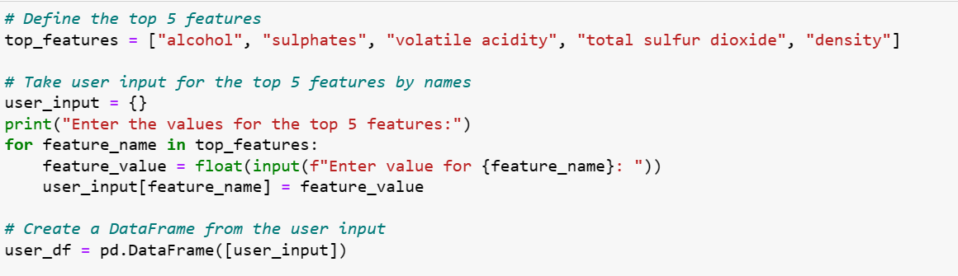
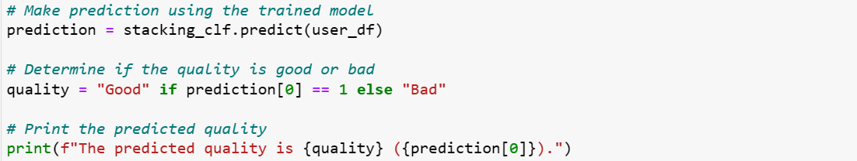
PREDICTION

Slide 14
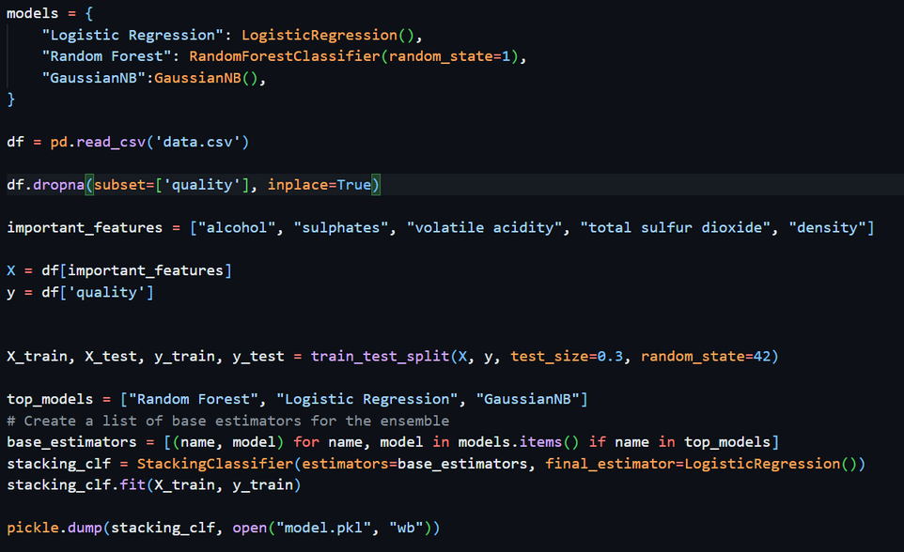
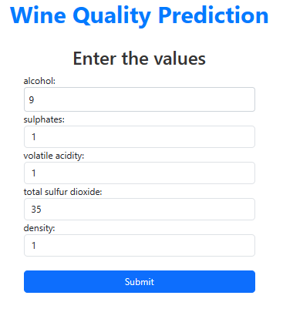
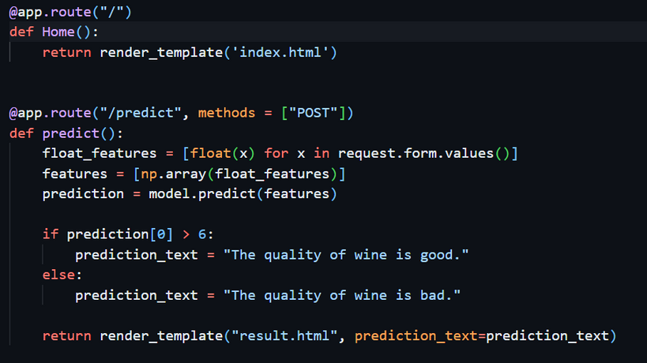
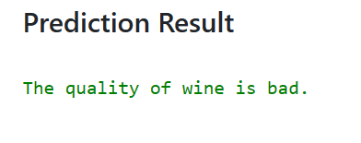
DEPLOYMENT AND USER INTERFACE

Slide 15
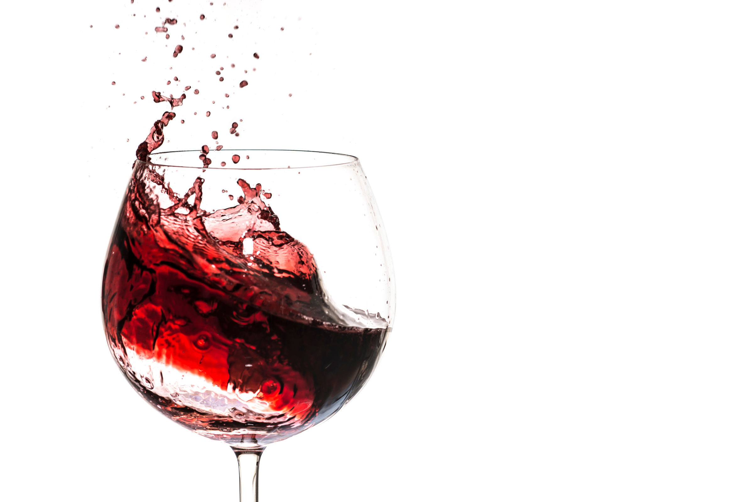
This comprehensive analysis of wine quality prediction has provided valuable insights and practical tools for the wine industry, data scientists, and enthusiasts alike. Through the utilization of machine learning algorithms, visualization techniques, and meticulous evaluation of influential factors, this study has shed light on the intricate relationship between chemical properties and wine quality. By uncovering patterns and trends within the dataset, it has facilitated a deeper understanding of the factors driving wine quality, empowering stakeholders to make informed decisions.
Conclusion

